Slide 1

Survey Data Analysis
Gulam Rasool Siddiqui 01/02/2025
Part 1

Slide 2



OUTLINE
Executive Summary
Introduction
Methodology
Results
Visualization – Charts
Dashboard
Discussion
Findings & Implications
Conclusion
Appendix

Slide 3

EXECUTIVE SUMMARY
Key Findings Highlights:
Current Top 10 Programming Language Preference: 83% of respondents are satisfied with the HTML/CSS, JavaScript and TypeScript, while 10% more respondents are eager to learn SQL and C#.
Database Top 10 Preferences: Over 90% of respondents prefer to work with PostgreSQL, and the preference is similar for those who want to use a database.
Platform Top 10 Preferences: Most of respondents prefer to work with AWS and then with Azure, and the preference is similar for those who want to use a platform.
WebFrame Top 10 Preferences: Most of respondents prefer to work with Spring Boot and then with React, and the preference is similar for those who want to use a WebFrame.
Overall Respondents Perception: It appears that most respondents are from the USA, with nearly 70% aged between 25 and 44 years. Most of them hold an associate's or master's degree.
Survey Scope and Objectives:
Scope: This survey was conducted globally across multiple countries, with a sample size of 18K+ respondents from different industries, including retail, finance, Helthcare, and technology.
Objectives: The primary aim was to measure which platform, language, web framework, and overall respondent engagement were involved in the survey.
Methodology: The survey was administered via online questionnaires and supplemented with in-depth interviews.
Impact Metrics:
Respondents Engagement: Respondents' interest appears to be the same for both current and future tools.
Actionable Insights: The analysis shows that further investment in cloud technology and support for higher education opportunities will lead to greater success for respondents.

Slide 4

INTRODUCTION
Systematic Collection of Data from Targeted Respondents
Structured approach using standardized questions and methods.
Carefully selected respondent groups based on demographic criteria.
Organized data gathering process with defined timelines.
Quality control measures throughout collection phases.
Primary Research Method for Gathering Direct Insights
First-hand information from actual users/customers.
Unfiltered feedback from target audience.
Direct measurement of respondent interest.
Tool for Evidence-Based Decision Making
Quantifiable metrics for platform and language usage.
Statistical validation of age and education levels.
Data-driven approach to analyze current vs. future IT tools usage.
Measurable outcomes for ROI calculations, enabling institutions to focus on platforms, programming languages, databases, age, and education levels.

Slide 5

METHODOLOGY
Research Design
Selection of survey type (descriptive, exploratory, causal)
Determination of data collection frequency
Setting measurement parameters
Establishing research timeline
Sampling Framework
Geographic and demographic considerations
Target population identification
Inclusion/exclusion criteria
Sampling technique selection like Random, Stratified, Cluster and Systematic sampling
Data Collection Methods
Online surveys (web-based, email) , Telephone interviews (CATI) , Face-to-face interviews , Mobile surveys, Paper-based questionnaires and Mixed-mode approaches
Questionnaire Design
Question types (multiple choice, Likert scale, open-ended), Response options formatting, Skip logic implementation and Pilot testing procedures
Quality Control Measures
Data validation techniques, Response verification processes, Duplicate entry prevention, Missing data handling and Data cleaning protocols
Documentation Standards
Methodology documentation, Variable definitions, Data dictionary and Analysis procedures

Slide 6
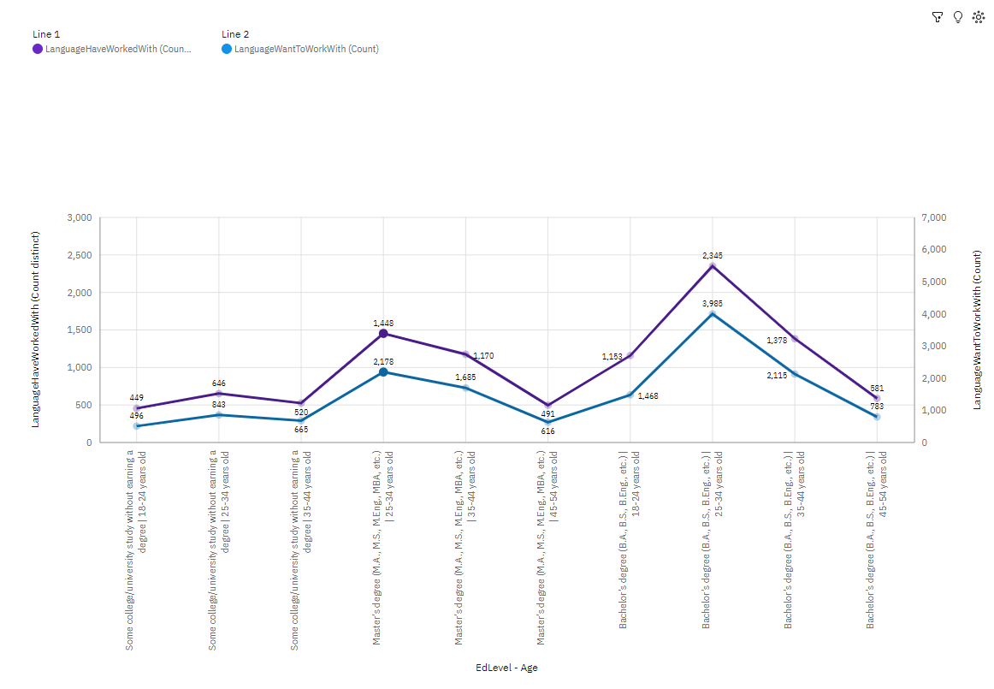
RESULTS
Overall, it appears that respondents aged 24 to 35 with a bachelor's or master's degree share similar interests in programming languages, as shown in the line graph.

Slide 7
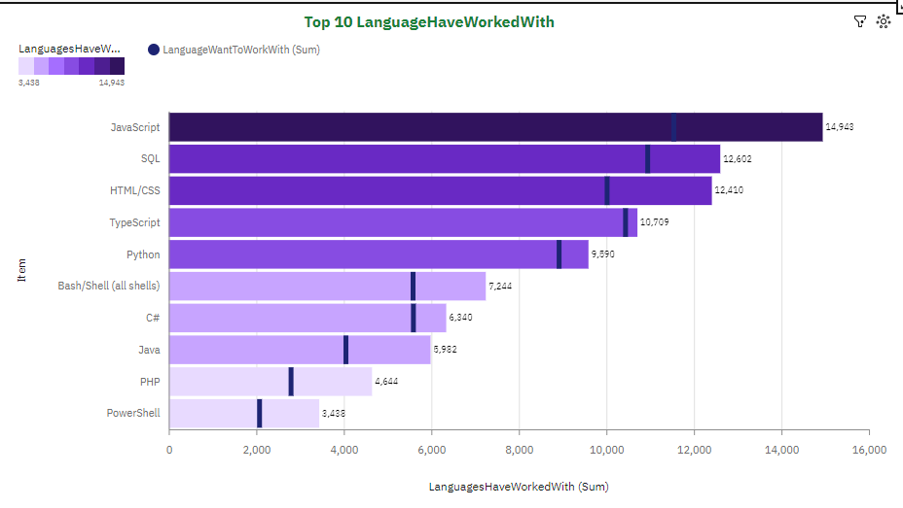
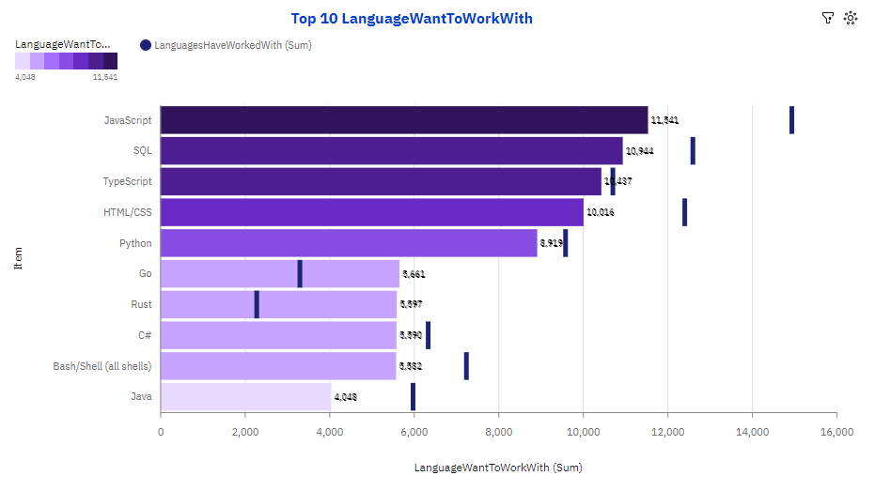
PROGRAMMING LANGUAGE TRENDS
Current Year
Next Year

Slide 8
PROGRAMMING LANGUAGE TRENDS - FINDINGS & IMPLICATIONS
Findings
Web Development JavaScript/TypeScript dominate frontend
Future Growth Indicators: SQL and C# with web development
Implications
Multi-language expertise increasingly valuable
Cloud-native development skills critical

Slide 9
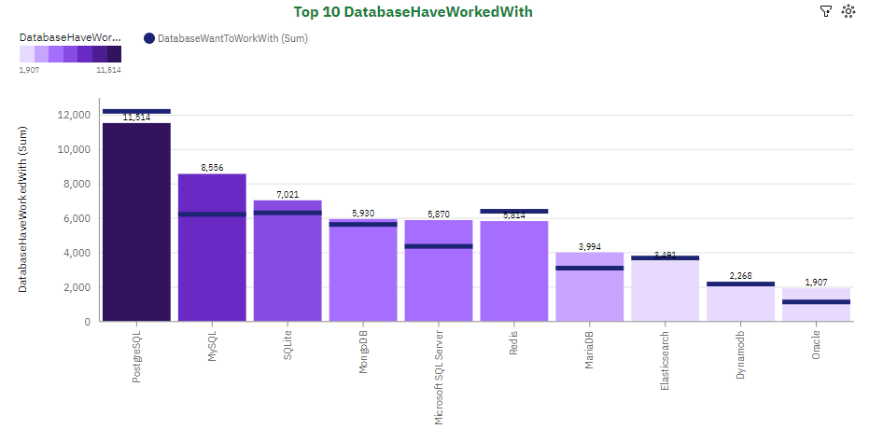
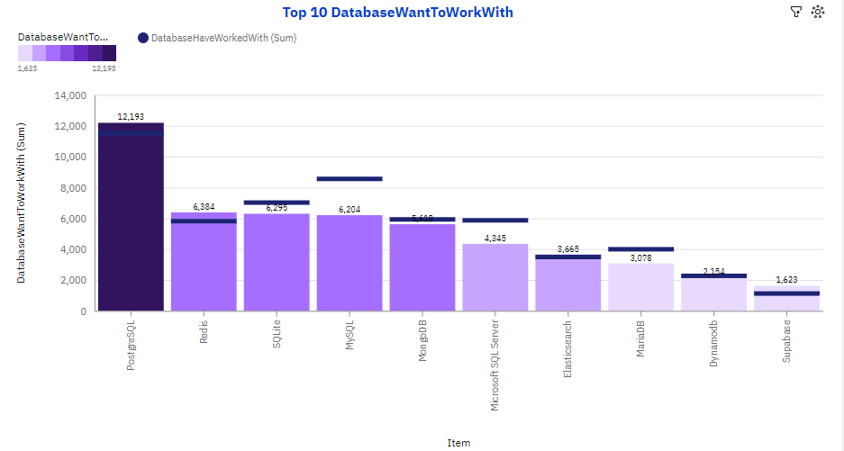
DATABASE TRENDS
Current Year
Next Year

Slide 10
DATABASE TRENDS - FINDINGS & IMPLICATIONS
Findings
The current trend shows that PostgreSQL leads in open-source adoption, while the future trend indicates that MongoDB is set to dominate the NoSQL space, and AWS Aurora is the fastest-growing cloud database.
Implications
Cost optimization through cloud databases has improved scalability with distributed systems, enhanced data security measures, and enabled easier real-time analytics capabilities.

Slide 11

DASHBOARD
https://github.com/GulamRasoolSiddiqui/Python-Project-for-Data-Science/blob/main/Survey%20Dashboard.pdf

Slide 12
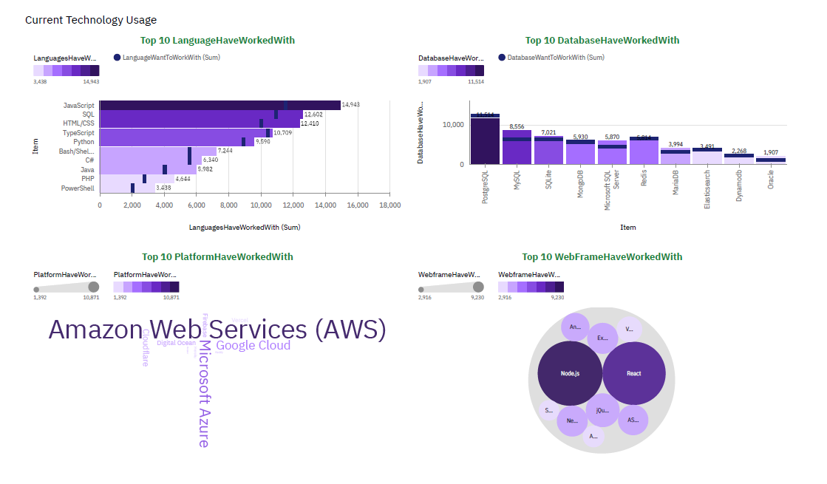
DASHBOARD TAB 1

Slide 13
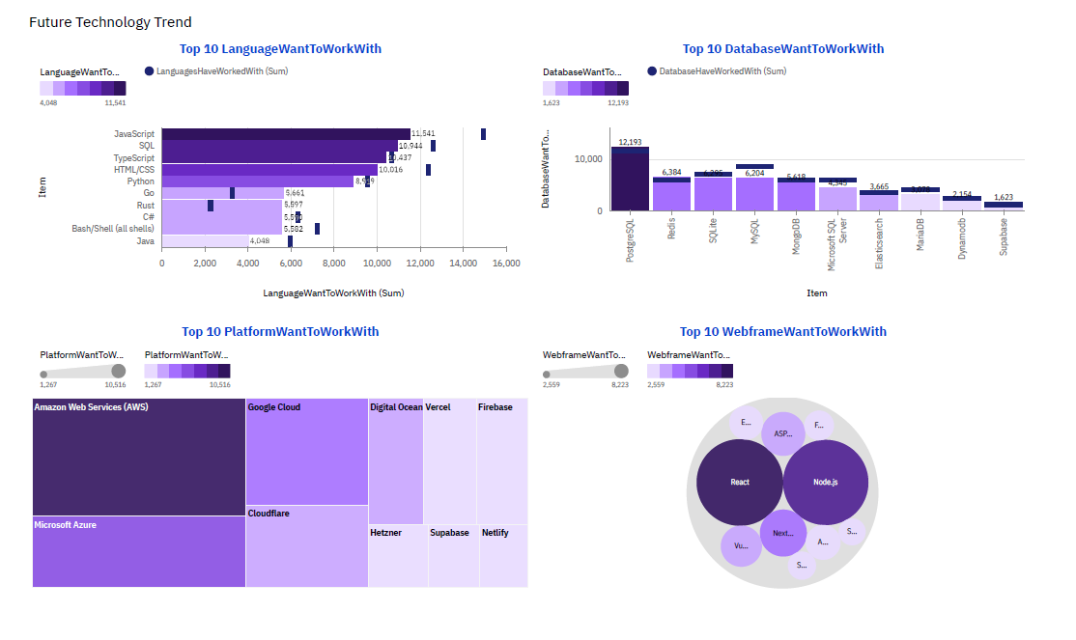
DASHBOARD TAB 2

Slide 14
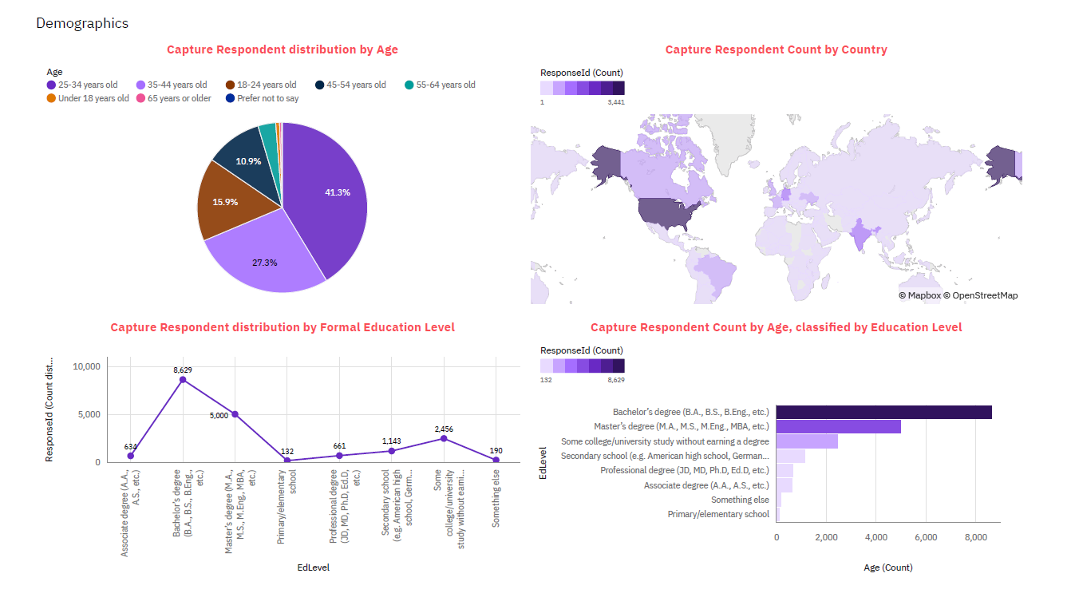
DASHBOARD TAB 3

Slide 15
DISCUSSION

Slide 16
OVERALL FINDINGS & IMPLICATIONS
Findings
Most of the respondents are from the USA and aged 24 to 35 with a bachelor's or master's degree share similar interests in programming languages, as shown in the line graph.
Implications
Accelerate cloud adoption strategies with the growth of serverless computing and the expansion of SQL and NoSQL database technologies. Additionally, knowledge of programming languages and web design further drives this growth.

Slide 17

CONCLUSION
Overall, it appears that respondents aged 24 to 35 with a bachelor's or master's degree share similar interests in programming languages. Further growth is expected in NoSQL, with a stronger focus on cloud-based MongoDB.

Slide 18

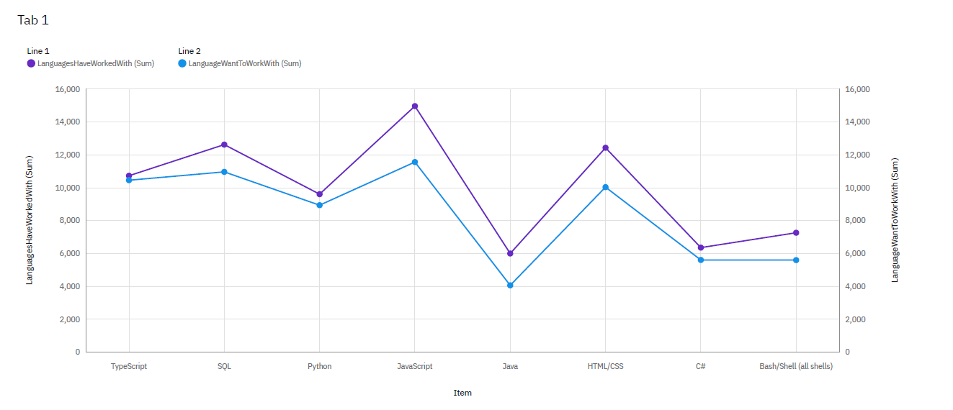
APPENDIX
Include any relevant additional charts, or tables that you may have created during the analysis phase.

Slide 19
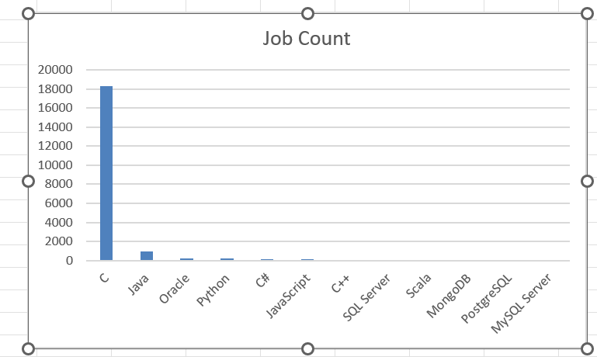
JOB POSTINGS
In Module 1 you have collected the job posting data using Job API in a file named “job-postings.xlsx”. Present that data using a bar chart here. Order the bar chart in the descending order of the number of job postings.

Slide 20
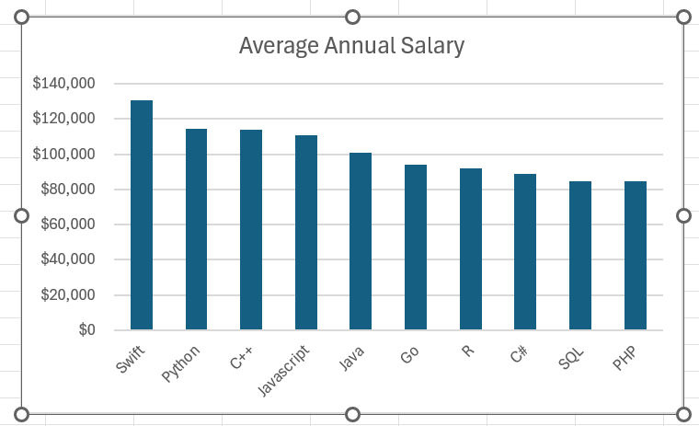
POPULAR LANGUAGES
In Module 1 you have collected the job postings data using web scraping in a file named “popular-languages.csv”. Present that data using a bar chart here. Order the bar chart in the descending order of salary.

